Slide 1
Lecture 15: Nuclear Imaging: Introduction & Principle
Dr. Guohua Cao （曹国华） caogh@shanghaitech.edu.cn
School of Biomedical Engineering
ShanghaiTech University
2/16/2023

Slide 2
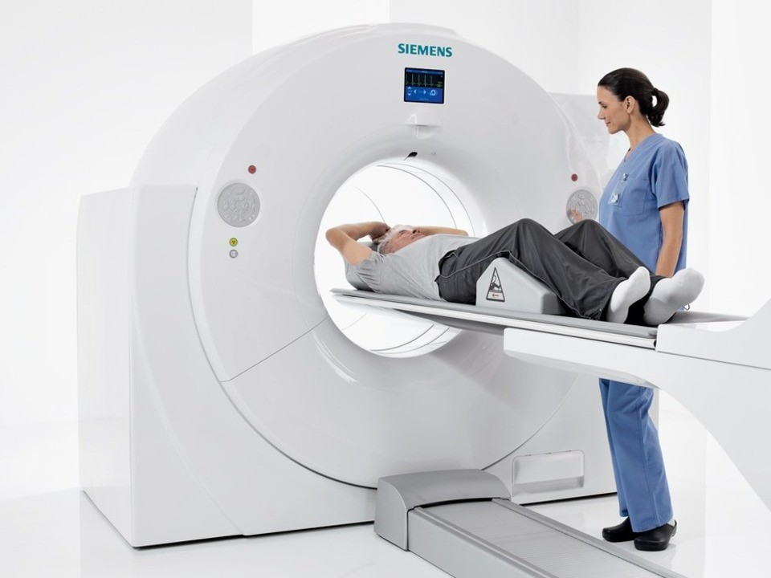
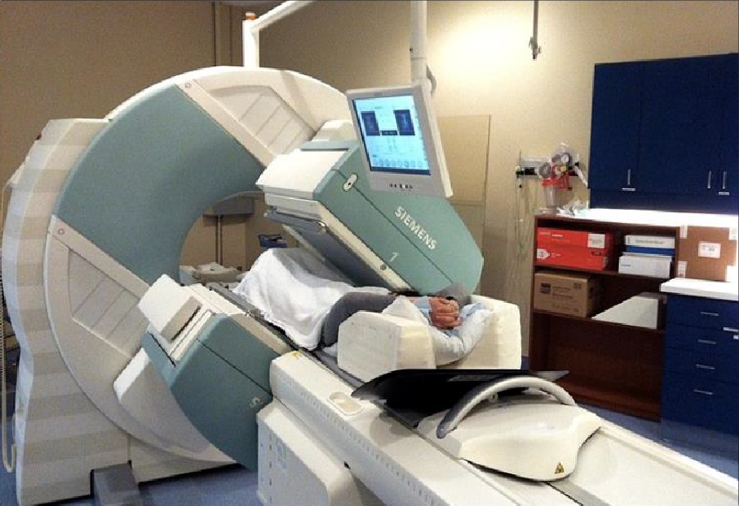
Nuclear Imaging Overview
PET
SPECT

Slide 3
Common Principle of Nuclear Imaging
Radioactive tracer is injected into subject
Uptake and distribution of tracer is influenced by subject physiology
Tracer undergoes radioactive decay and emits gamma rays
Gamma rays are detected by nuclear imaging camera and events stored
Data is reconstructed into image estimate of tracer distribution and uptake

Slide 4
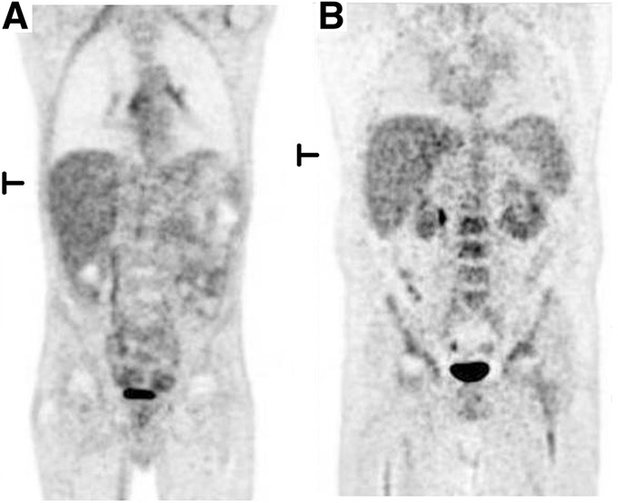
Example PET Image

Slide 5








Electromagnetic Spectrum
Optical Imaging
X-ray Nuclear Imaging Imaging
MRI
Radiation Type Wavelength (m)
Radio
10³
Microwave
₁₀−2
Infrared
₁₀−5
Visible
0.5×10 ⁻⁶
Ultraviolet
₁₀−8
X-ray
₁₀−10
Gamma ray
₁₀−12
Approximate Scale of Wavelength
Buildings
Humans
Butterflies
Needle Point Protozoans
Molecules
Atoms
Atomic Nuclei
Frequency (Hz)
10 ⁴
10 ⁸
₁₀12
₁₀15
₁₀16
₁₀18
₁₀20

Slide 6
Signal Sensitivity Comparison
Imaging Method | Sensitivity
Ultrasound | 10⁻³ Mol
CT | 10⁻³ Mol
MRI | 10⁻⁵ Mol
Bioluminescent | 10⁻⁸ Mol
Nuclear* | ₁₀-9₋₁₀-12 | Mol

Slide 7
Nuclear Imaging Source
radionuclide = atom with a specific number of neutrons and protons that undergoes radioactive decay
A _{X}
Z N
A= mass number (#protons + neutrons=nucleons)
Z= atomic number (#protons)
N= neutron number (#neutrons)

Slide 8
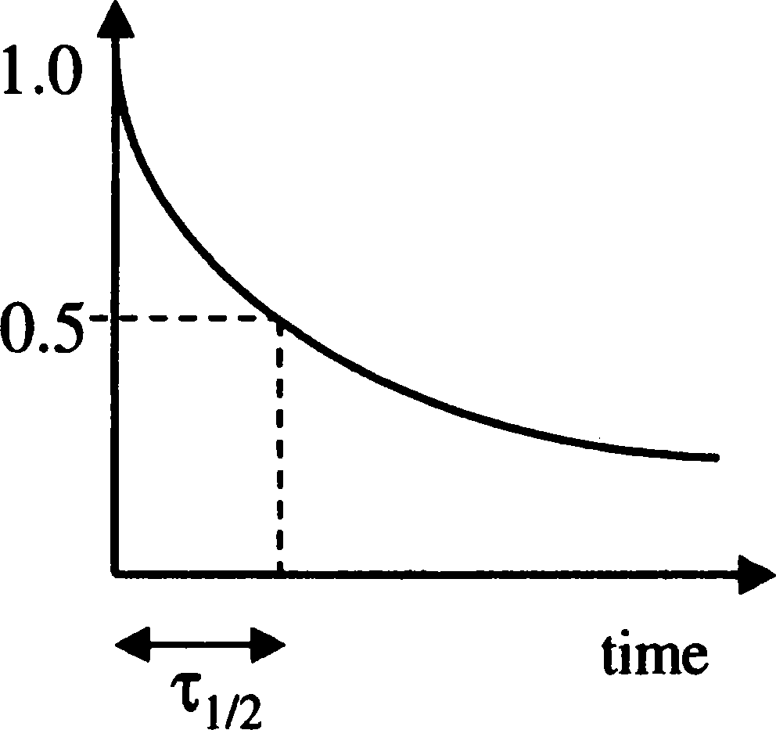
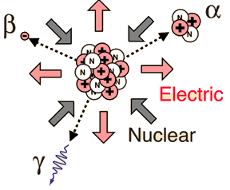
N N₀ = exp(−λt)
Radioactive Decay
Radioactive decay= mechanism by which an unstable nucleus is converted into a more stable one by emission of particles or photons
Half-life (τ_{1/2})= amount of time it takes a sample of radioactive atoms to halve
λ = decay constant in inverse time

Slide 9
Units of Activity
Bequerel (Bq)= SI unit defined in decays a second (dps)
Curie (Ci) = more commonly used for medical imaging
1 Ci = 37e10 Bq 1 mCi = 37 MBq
For nuclear imaging amounts of activity used are in the tens of µCi to tens of mCi
Particular activity amount used is determined by scanner capabilities, subject habitus, and tracer half-life

Slide 10
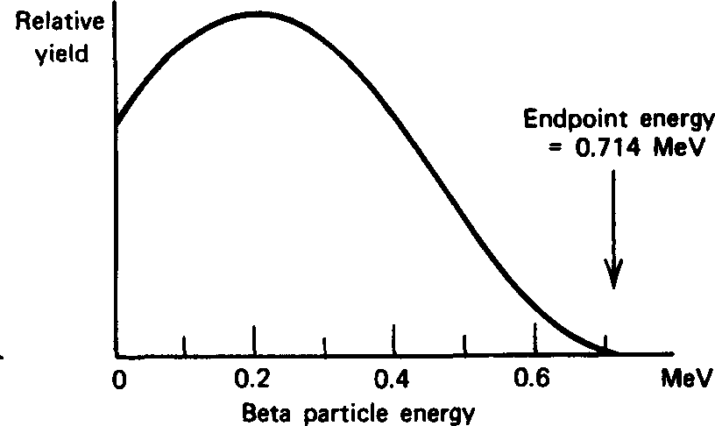
n → p⁺ + e⁻ + ν + energy
β⁻ and (β⁻,γ) Decay
_{β} −
Y
A A
_{Z} X →_{Z+1}
_{β} −
A
A * γ A
_{Z} X → _{Z+1}Y → _{Z+1}Y
Examples
131_{I,} 201_{Tl}

Slide 11
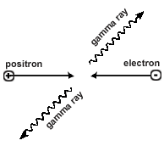
p⁺ → n + e⁺ + ν + energy
β⁺ and (β⁺,γ) Decay
_{Z} X → _{Z-1}Y
_{Z} X → _{Z-1}Y → _{Z-1}Y
Annihilation Reaction
Positron and stationary electron produce two back-to-back 511 keV gamma rays (¹⁸F, ¹¹C, ⁸²Rb)
_{β} +
A A
_{β} +
A
A * γ A

Slide 12
p⁺ + e⁻ → n + ν + energy
Electron Capture (EC) and (EC, γ) Decay
A _{Y}
A
EC
X →
Z Z-1
Electron from closest orbits are usually the electrons captured (i.e. K or L shells)
Electron vacancy produces characteristic x-rays which can also be detected if of significant energy
Examples
67_{Ga}

Slide 13
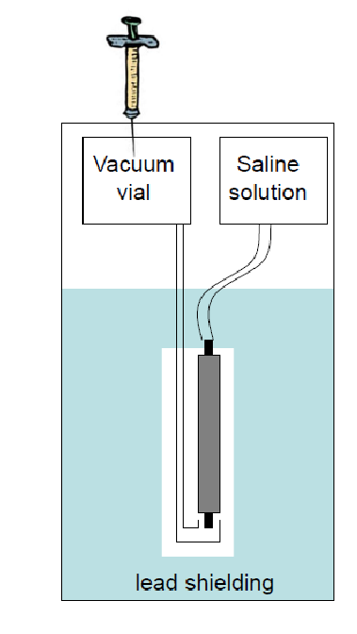
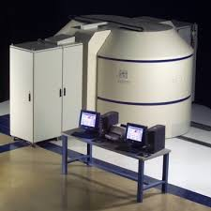
Radionuclide Production
Generators
Cyclotron
Generator = Device that houses parent daughter radionuclide pair and allows extraction of the daughter
Cyclotron = Uses high power magnets to accelerate and collide very high energy charged particles into specialized targets

Slide 14
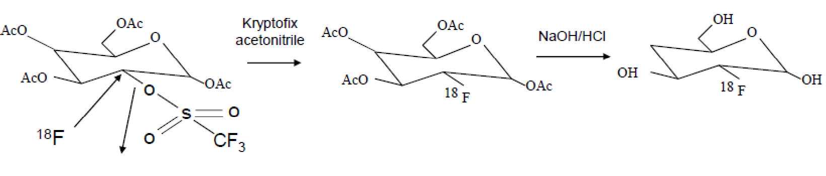
Radiopharmaceutical Production
¹⁸F-Fluordeoxyglucose (FDG) synthesis
Two general labeling schemes
Direct substitution= Exchange of the stable atom with a radionuclide of the same chemical element
Analogs = Exchange of stable atom with a radionuclide of a
different chemical element (e.g. ¹⁸FDG)

Slide 15
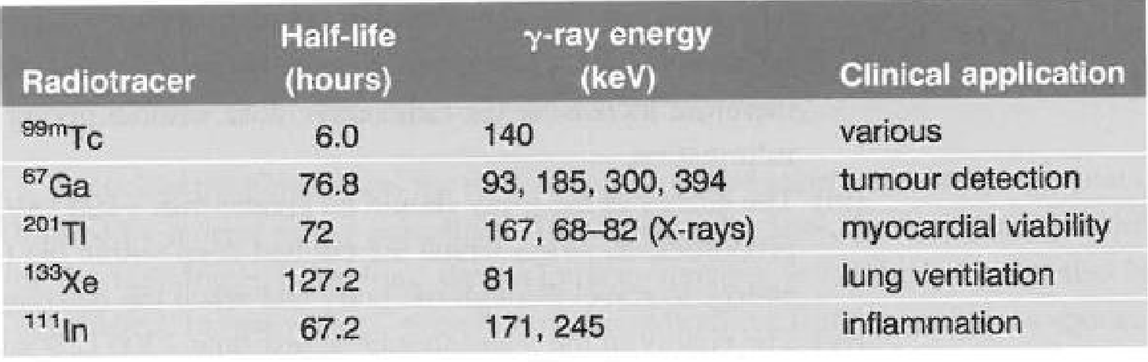
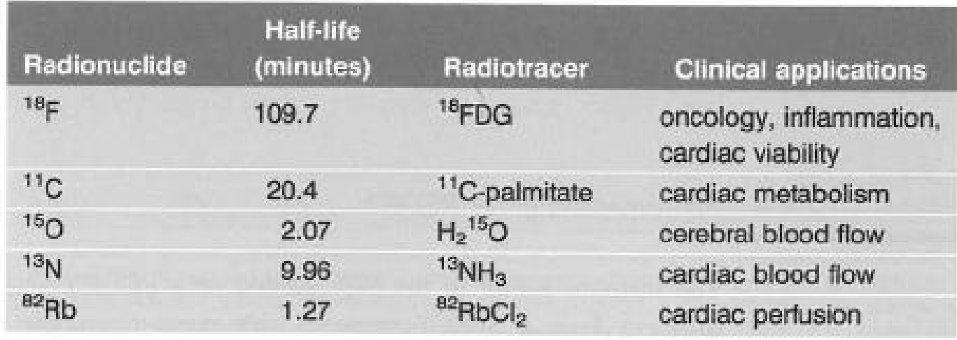
Radiopharmaceuticals for Medical Imaging
SPECT
PET

Slide 16
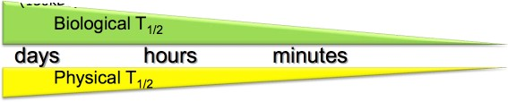
Effective Half-life
Biological half-life (τ_{bio})= rate that radiopharmaceutical is removed from the body
^{1 τ} eff ^{= 1 τ}1/2 ^{+1 τ} bio
¹⁸FDG (metabolism)
¹¹C-Choline
(receptor binding)
Cell tracking
¹⁵O-H2O
(blood flow)
seconds
⁶⁴Cu 12.7 h
¹⁸F 1.9 h
¹¹C 20 m
¹⁵O 2 m

Slide 17
Radiopharmaceutical Preferred Qualities
Gamma ray emission in acceptable energy range
50-600 keV for min subject and max detector attenuation
Particulate and low energy gammas only add dose
Radionuclide and biological half-lives are similar
Radionuclide half-life must be >= to biological process, but if too long will add dose to subject and minimize scan SNR
Total mass introduced to subject does not alter physiology
Typically ng levels

Slide 18
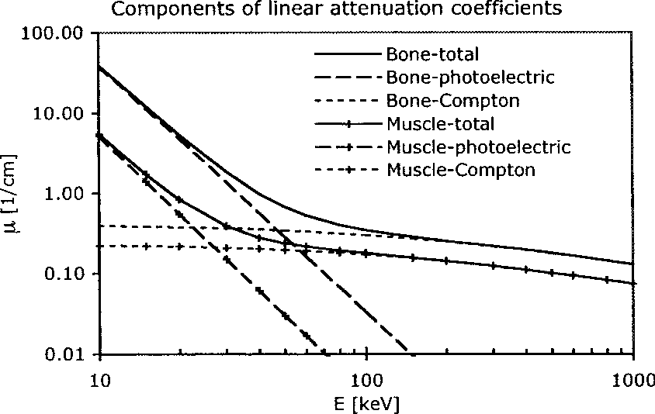
Interaction of Gamma Rays With Matter
Gamma rays interact with the subject and scanner mainly through the
photoelectric effect and Compton scattering
Compton scattering dominates µ at nuclear imaging energies!
µ for biological tissues is typically significantly lower at nuclear imaging energies c/w x-rays
Consequence
More material or material with higher µ/ρ is required in nuclear imaging to attenuate photons than x-ray imaging

Slide 19
Attenuation Properties of Interest
Mass Attenuation Coefficients
80 keV
CT
500 keV _{~PET}
Ratio of totals
Material | Photoelec. | Compton | Total |  | Photoelec. | Compton | Total |  | 80 keV:500 keV
Air | 0.006 | 0.161 | 0.167 |  | ,0.001 | 0.087 | 0.087 |  | 1.92
Water | 0.006 | 0.178 | 0.184 |  | ,0.001 | 0.097 | 0.097 |  | 1.90
Muscle | 0.006 | 0.176 | 0.182 |  | ,0.001 | 0.096 | 0.096 |  | 1.90
Bone | 0.034 | 0.175 | 0.209 |  | ,0.001 | 0.093 | 0.093 |  | 2.26
Teflon | --- | --- | 0.168 |  | --- | --- | 0.087 |  | 1.93
Lead | - | - | 2.419 |  | - | - | 0.164 |  | 14.75
Tungsten | - | - | 7.810 |  | - | - | 0.138 |  | 56.52
Half Value Layers (mm)
Material |  | 80 keV |  | 500 keV | Ratio (500 keV:80 keV)
Water | 41.51 |  | 71.46 |  | 1.72
Bone | 17.27 |  | 38.82 |  | 2.25
Lead | 0.25 |  | 3.72 |  | 14.88

Slide 20






Nuclear Counting Systems
What are the basic requirements necessary to efficiently count gamma rays?
140 keV
Gamma Ray Detector
Signal Conditioning + Processing
320 keV
ADC
Computer
Detect gamma rays
Distinguish energy of photons
Separate detection of photons in time

Slide 21

Scintillation Detectors
Scintillator
Photodetector
Ionizing Radiation
Light
Scintillator= attenuates and converts incident radiation into light near the visible spectrum (both visible and UV)
Photodetector = Converts photons from scintillation light to an amplified electrical signal

Slide 22
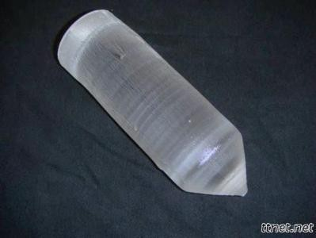
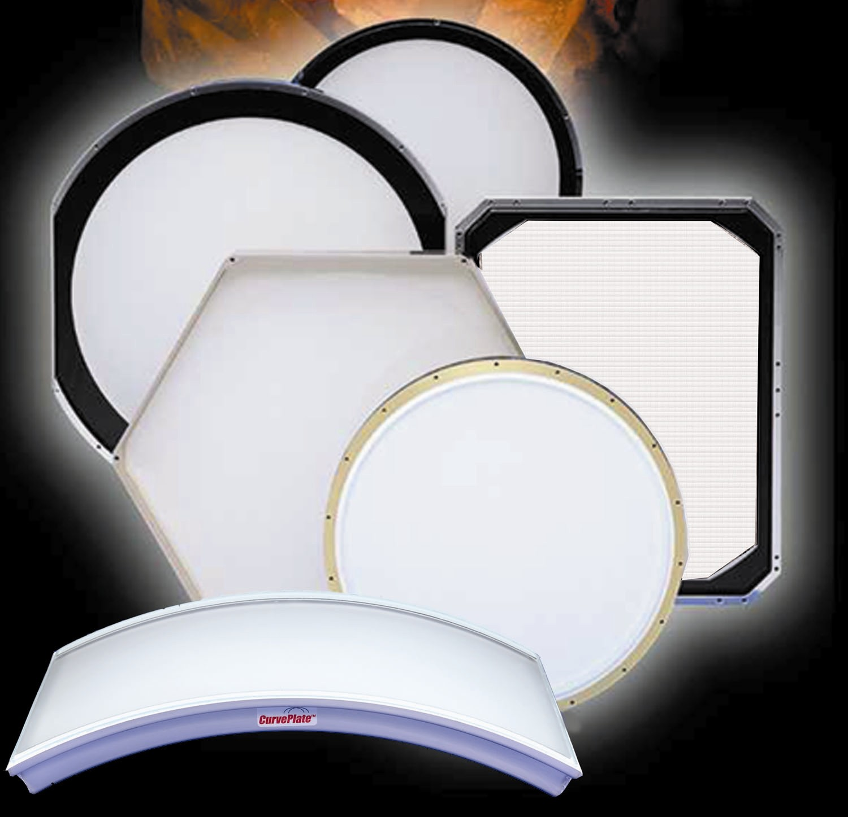
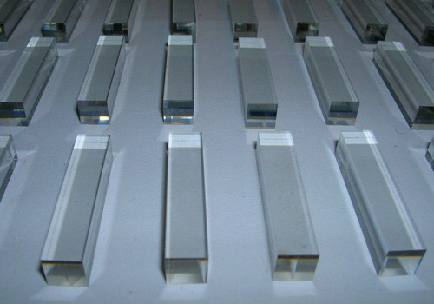
Scintillators
Organic: Scintillation is inherent property of the molecule (not used in nuclear imaging)
Inorganic: Ionic crystalline solids that convert energy into light by
nature of structure
Inorganic mechanism: Photoelectric and Compton interactions excite electrons which produce light upon return to ground state
Number of scintillation photons produced is proportional to absorbed gamma ray energy!

Slide 23
Important Scintillator Properties
Attenuation Coefficient: Determines sensitivity of scintillator for absorbing high energy photons. Dependent on Z and density.
Light Yield: Efficiency of scintillator to convert absorbed γ energy to scintillation light. Influences energy separation of detector.
Decay Time: Speed of the scintillation pulse. Time for amplitude to return to 1/e
Property |  | NaI(Tl) |  | CsI(Tl) | LSO
Density (g/cm³⁾ | 3.67 |  | 4.51 |  | 7.40
Effective Z | 50 |  | 54 |  | 66
Decay time (nsec) | 230 |  | 1000 |  | 40
Photon Yield (per keV) | 38 |  | 52 |  | 20-30

Slide 24
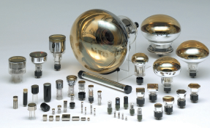
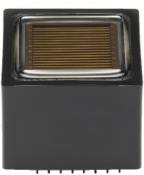
Photodetectors
Purpose: Convert photons from scintillation light to an electrical signal
Photomultiplier Tubes (PMTs)

Slide 25





Readout Electronics
High Voltage Power Source
PMT
Amplifier
Computer |  | Pulse-Height Analyzer
ADC
High Voltage Source: Relatively high (~1000 V) and stable (<1% variation) for PMTs
Amplifier: Amplifies low voltage signal from PMT and shapes pulses
Pulse-Height Analyzer: Histograms amplitude (energy) of pulses to produce energy spectrum

Slide 26
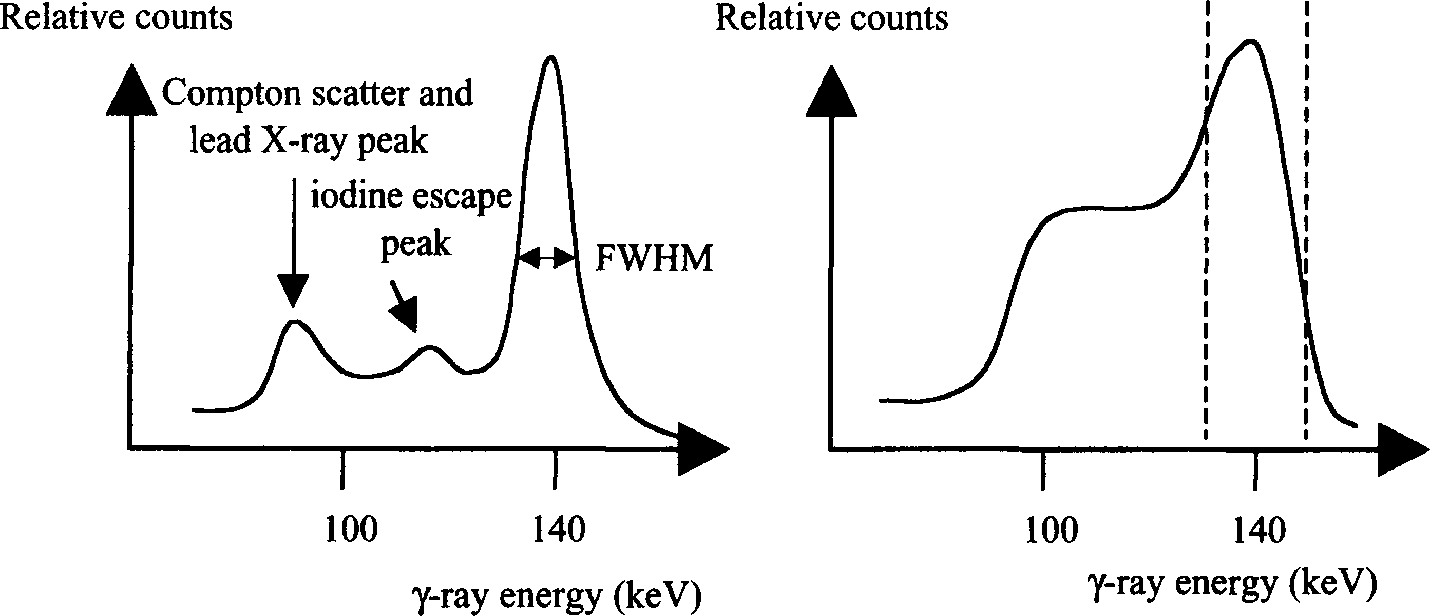
Energy Spectra
Energy Resolution = (FWHM of photopeak)/(true energy)

Slide 27

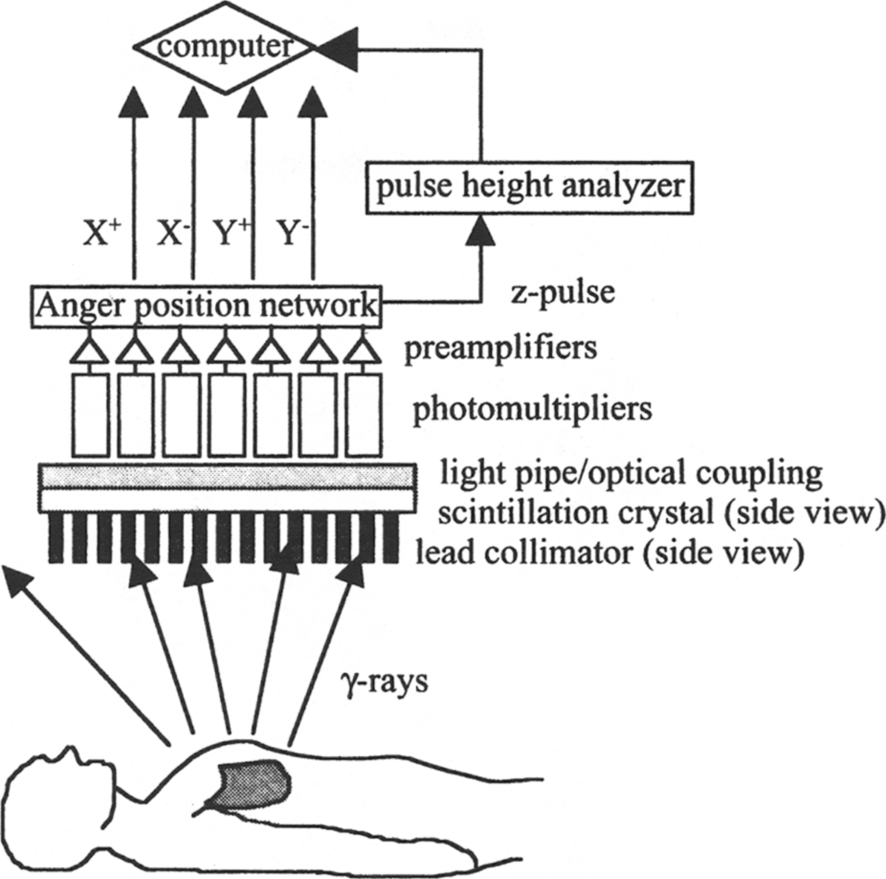
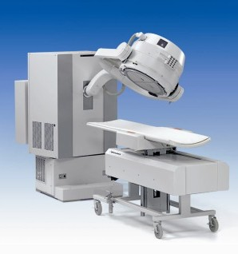
Gamma Camera Overview

Slide 28
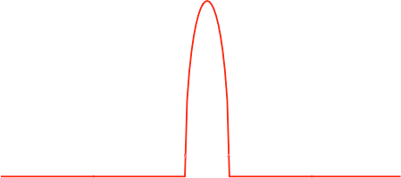

Collimator Function
Purpose: Projects image of tracer distribution onto scintillator by restricting the gamma ray incident angle range
Projection on scintillator
True
Septa: Lead (high Z materials) walls surrounding holes that attenuate incident gamma rays

Slide 29
Collimator Function
Purpose: Projects image of tracer distribution onto scintillator by restricting the gamma ray incident angle range
Projection on scintillator
True
Measured
Septa: Lead walls surrounding holes that attenuate incident gamma rays

Slide 30


Collimator Function and Photon Binning
2D Image Formed by Scintillator
Photons are binned in space based on position along the sctintillator face
Image is formed by the different counts in each histogram bin

Slide 31
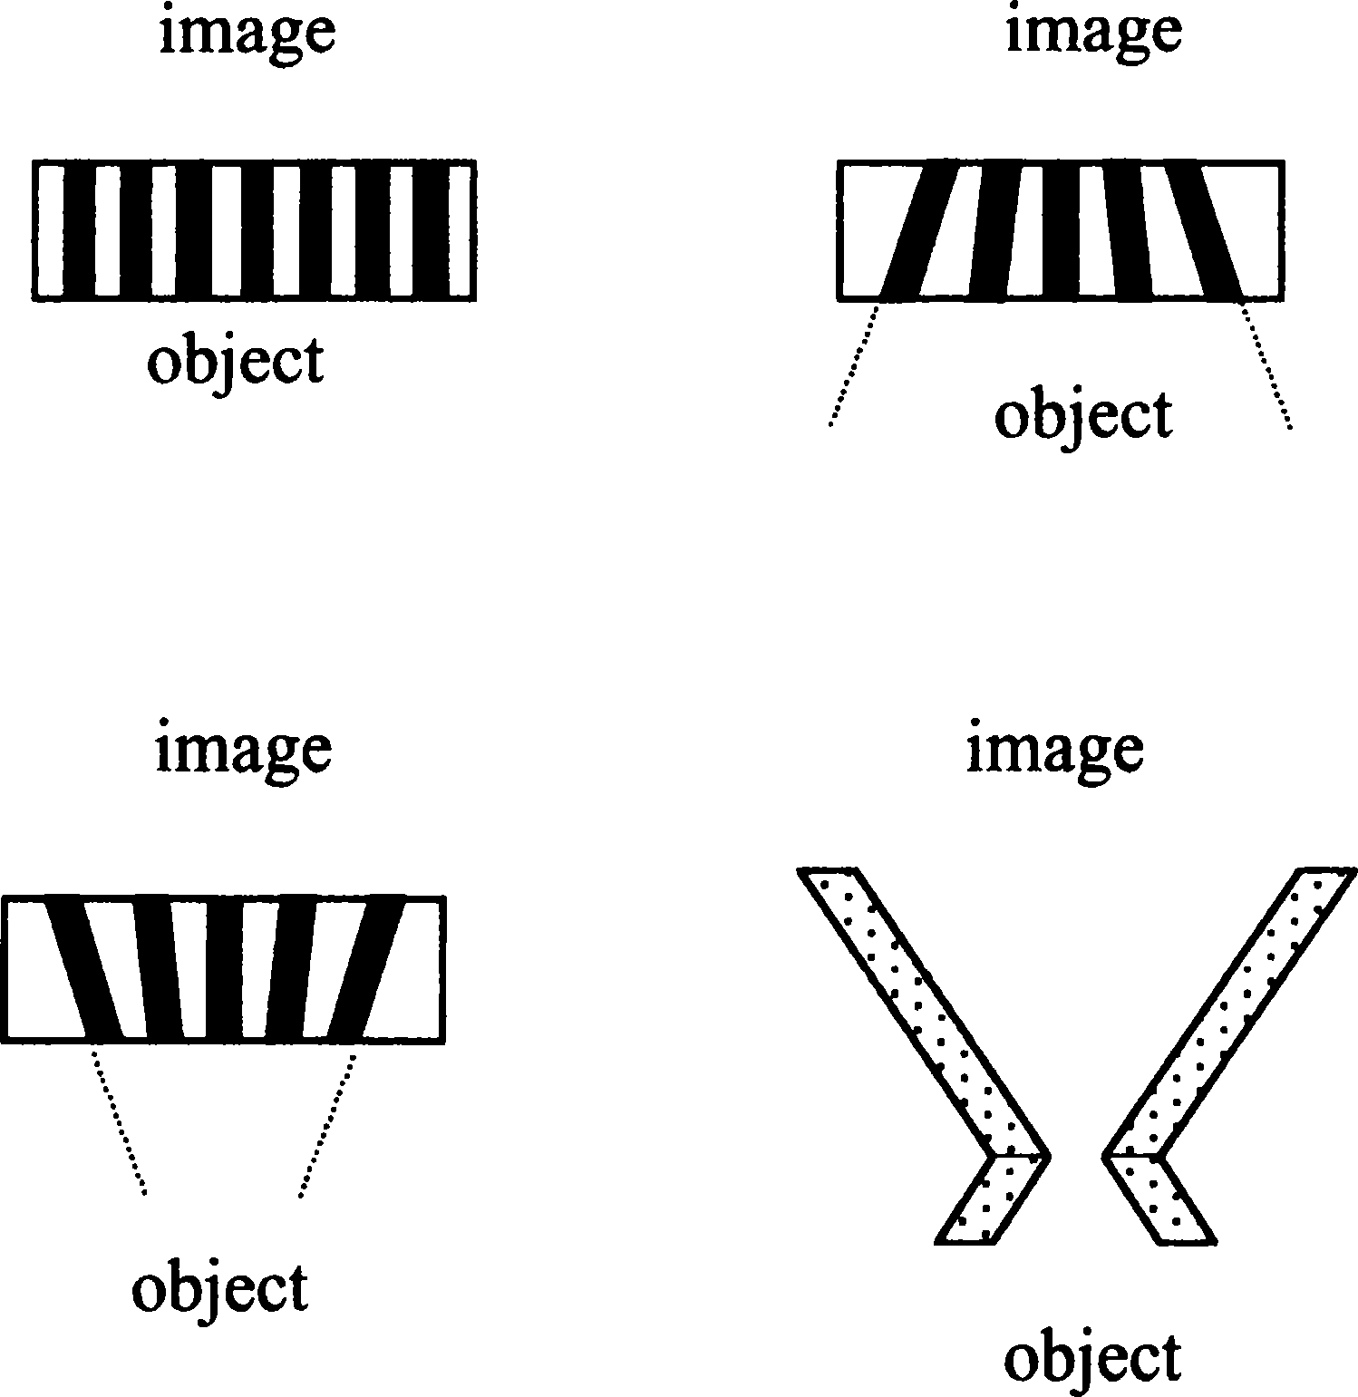
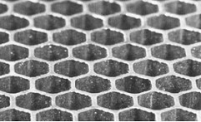
Collimator Types
Parallel Hole
Diverging
Different designs control magnification / minification, of object and FOV
Parallel hole collimator is most frequently used
Converging
Pinhole
Magnified Collimator View

Slide 32
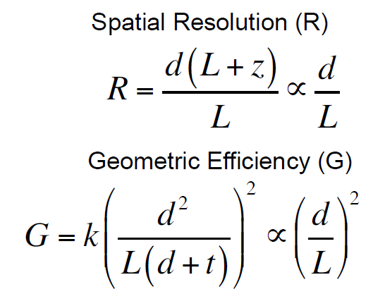

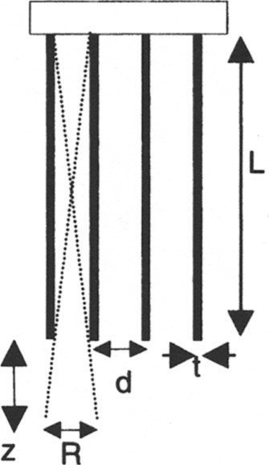
Parallel Hole Collimator Performance
k=constant related to collimator hole shape (5.8e-2 to 7.8e-2)
Geometric efficiency= fraction of γ-rays passing through collimator per a source γ-ray emission
Geometric efficiency for parallel hole collimator is independent of distance to subject (z)

Slide 33
Parallel Hole Collimator Performance Tradeoffs
1. Collimator geometric efficiency and resolution are strongly linked
Improving Resolution
Reduction in Geometric Efficiency
Reduction in Image SNR
2. Geometry needs to be optimized for the energy of the γ-rays to be imaged
Increasing Energy
Reduction in Septal Material Attenuation
Requires thicker septa to attenuate γ-rays

Slide 34
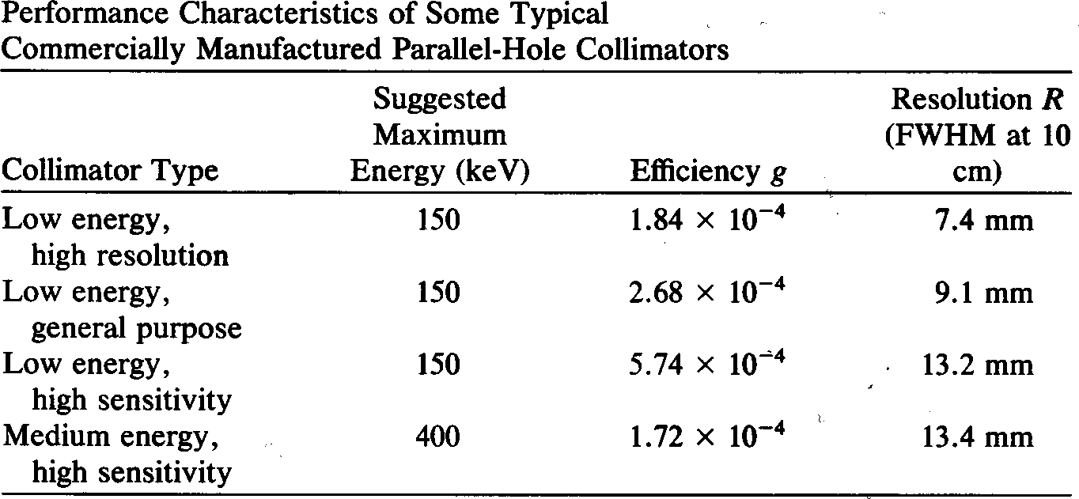
Parallel Hole Collimator Performance Examples
Different parallel hole collimator geometries are needed to image different combinations of radionuclides and clinical applications
Geometric

Slide 35
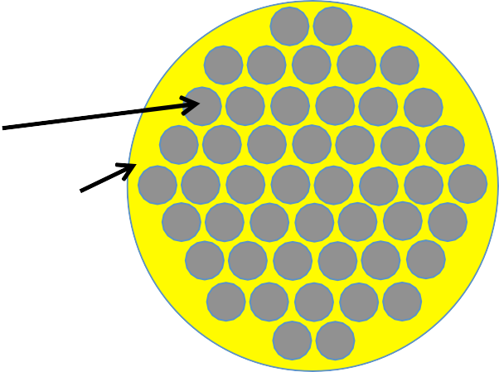
Gamma Camera Scintillation Detector
Side View Back View
PMTs
NaI(Tl) Crystal
Light Guide
NaI(Tl) Crystal = single continuous large area scintillator (25-50 cm diameter) and ~1 cm thick
Light Guide = spreads out and guides light to improve event positioning and avoid dead areas
PMTs = hexagonal array allows for positioning of γ-ray interactions in the NaI(Tl) crystal using Anger logic.

Slide 36

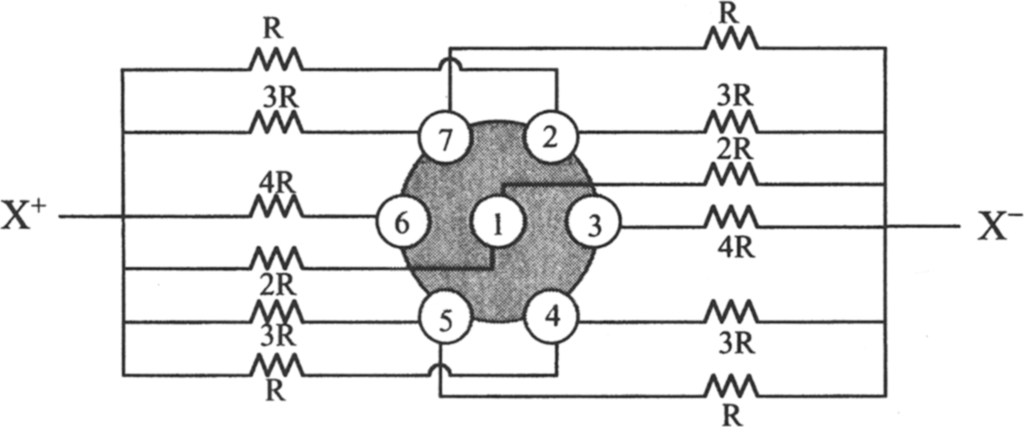
Anger Logic
Purpose: Calculate 2D γ-ray interaction point along face of crystal using signal amplitude from PMT array
Anger Logic Circuit
signal
X Position for Logic Circuit
(X ⁺ −X ⁻ )
X =
(X ⁺ +X ⁻ )
γ-ray

Slide 37
Intrinsic Spatial Resolution
Accounts for effects of scintillator and electronics alone
Depends on two main factors:
Degree of multiple Compton scattering in scintillator
Statistical fluctuations of scintillator photons
T
γ-ray
Increasing γ-ray energy
Increase in scintillation photons
Improvement in intrinsic resolution
Increasing crystal T
Increase in multiple scatter events
Reduces intrinsic resolution

Slide 38
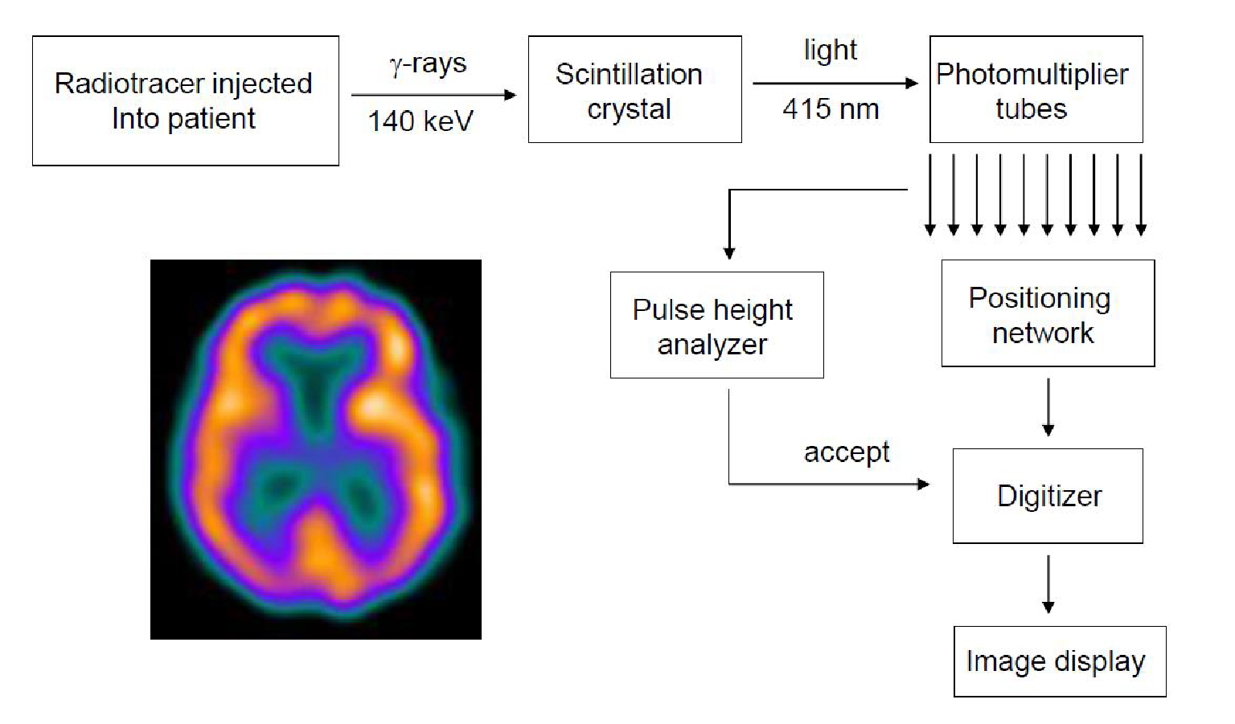
Data Acquisition Electronics

Slide 39
Energy Windowing
Energy Window
Photopeak
Scattered events carry little information about the tracer distribution (reduce image spatial resolution)
Selecting only events in a certain energy range (energy window) greatly reduces influence of scatter
Compton Scatter

Slide 40
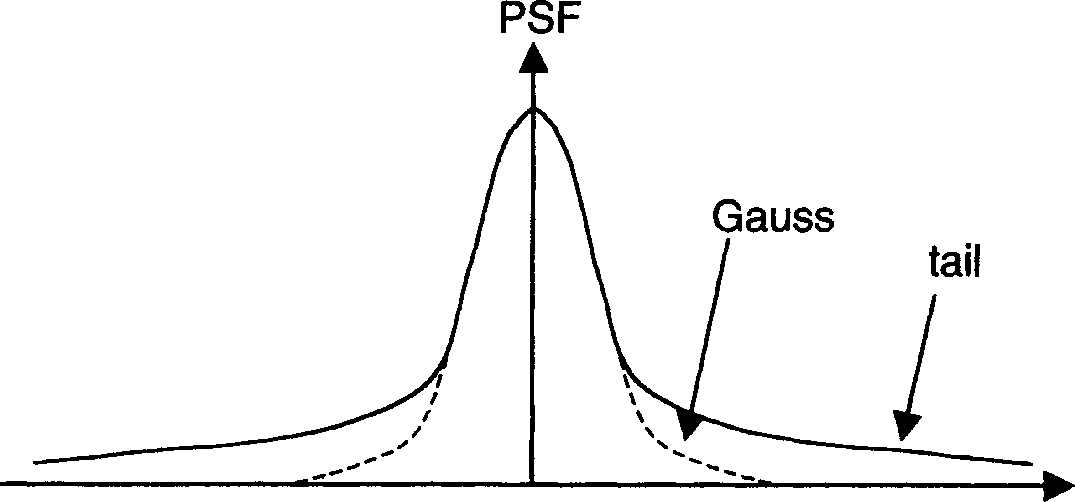
System Spatial Resolution
Influenced by collimator, intrinsic spatial resolutions, and Compton scattering in the subject
_{R}2
^{R}system ⁼
R
2
R
2
Compton
gamma
coll
Intrinsic
Collimator Compton
Collimator resolution has the largest impact on system resolution
Compton scatter mainly influences the tails of the PSF
Formula is only valid for a given distance from the collimator
Typically 8-14 mm for ^{99m}Tc

